Slide 1
Capstone Project 1: Analysis of Departure Delays in the U.S.
Jonathon Poage
Springboard Data Science Career Track
3/10/2019

Slide 2
Outline
Introduction
Data
Flight Data
Weather Data
Analysis
Departure Delay Distributions
Weather Conditions
Important Weather Variables
Conclusion

Slide 3
Introduction

Slide 4
Problem
Departure delays for commercial flights can negatively impact passengers, airlines, and airports in significant ways.
Even a one minute reduction in the average departure delay duration would be practically significant.
This project analyzed departure delays for non-stop domestic flights in the United States from 2016 and 2017.
This project focused primarily on the relationships between departure delays and weather variables.

Slide 5
Goals of the Analysis
Examine characteristics of the departure delay distributions for U.S. airline carriers and airports.
Examine departure delays under various weather conditions.
Determine whether certain weather conditions have significantly higher mean departure delays than clear conditions.
Determine whether there is a significant association between airports and weather conditions.
Identify relationships between departure delay duration and weather variables.
Determine the most important weather variables and their practical significance.
Identify airports with the worst conditions for certain weather variables.

Slide 6
Benefits of Results
Airport authorities could use the results of this analysis to better anticipate departure delays under certain conditions.
More accurate scheduling of departures could improve:
Efficiency of airport operations.
Management of resources.
Passenger satisfaction.
Revenue.
Potential areas of improvement are identified. Further analysis could investigate ways to reduce departure delay durations.

Slide 7
Data

Slide 8
Flight Data
On-time performance data for flights was obtained from the Bureau of Transportation Statistics (BTS) website.
Each data point represents a flight.
This analysis focused on the following:
Flights for the top 8 largest U.S. airline carriers.
Flights departing from the top 10 busiest U.S. airports.
Relevant variables include:
Scheduled departure time
Departure delay
Origin airport IATA code
Airline IATA code
Reported cause of delay categories
Cancelled flight indicator

Slide 9
Airports and Airline Carriers
Top 8 largest U.S. airline carriers based on passengers carried in 2017. The list is based on data from T-100 Domestic Market (U.S. Carriers) and T-100 Market (US Carriers Only).
Top 10 busiest U.S. airports by total passenger traffic in 2016. The list is based on data from the file: 2016 North American Airport Traffic Summary (Passenger).
Airport Name | IATA Code | Total Passengers
Hartsfield–Jackson Atlanta International Airport | ATL | 104,171,935
Los Angeles International Airport | LAX | 80,921,527
O'Hare International Airport | ORD | 77,960,588
Dallas/Fort Worth International Airport | DFW | 65,670,697
John F. Kennedy International Airport | JFK | 59,105,513
Denver International Airport | DEN | 58,266,515
San Francisco International Airport | SFO | 53,099,282
McCarran International Airport | LAS | 47,496,614
Seattle–Tacoma International Airport | SEA | 45,736,700
Miami International Airport | MIA | 44,584,603
Airline Carrier Name | IATA Code | Enplaned Passengers (Domestic & International)
Southwest Airlines Co. | WN | 157,727,005
Delta Air Lines, Inc. | DL | 145,436,827
American Airlines, Inc. | AA | 144,919,764
United Airlines, Inc. | UA | 107,161,566
JetBlue Airways Corporation | B6 | 40,013,934
Alaska Airlines, Inc. | AS | 26,110,618
Spirit Airlines, Inc. | NK | 23,812,748
Frontier Airlines, Inc. | F9 | 16,799,968

Slide 10
Weather Data
Weather data was obtained from https://mesonet.agron.iastate.edu/request/download.phtml.
The data originated from Meteorological Terminal Aviation Routine Weather Reports (METARs). METARs are typically generated hourly.
Each data point represents a weather observation.
Relevant variables include:
Station
Observation time
Air temperature
Relative humidity
Wind Speed
Wind gust
One hour precipitation
Pressure altimeter
Visibility
Sky level 1 altitude
Sky level 1 coverage
Present weather codes

Slide 11
Sky Level Altitude and Coverage
The sky level altitude and coverage variables contain information about the sky condition.
Only sky level 1 is included in this analysis. Sky levels 2 through 4 are excluded for simplicity.
Clear skies are indicated by sky level 1 coverage values of CLR or SKC. There is no sky level 1 altitude for clear skies.
For this analysis, the custom value of 42,000 feet was assigned to the sky level 1 altitudes associated with clear skies. This value was chosen after considering typical service ceilings for commercial aircraft.

Slide 12
Merged Dataset Preprocessing
Flight Data
Preprocessing
Weather Data
Merged Dataset
Flight and weather data was merged into a single dataset.
Data points were matched based on station, scheduled departure time, and weather observation time.
Data was preprocessed to prepare the merged dataset for analysis.

Slide 13
Analysis Part 1
Departure delay distributions

Slide 14
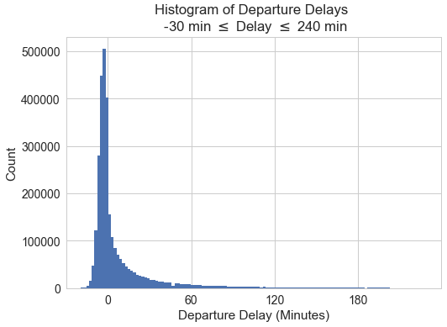
Overall Departure Delay Distribution
Descriptive statistics for the overall distribution of departure delays.
Statistic | Value (Minutes)
Mean | 10.5
Sample Standard Deviation | 38.9
Minimum | -234
25th Percentile | -4
50th Percentile | -1
75th Percentile | 8
Maximum | 2,149
At least half of the flights departed early.
Most flights departed within several minutes of the scheduled departure time.
The distribution has a positive skew, with some delays lasting hours.
Relatively few flights departed more than 30 minutes early or 240 minutes late. These data points were not included in the histogram.

Slide 15
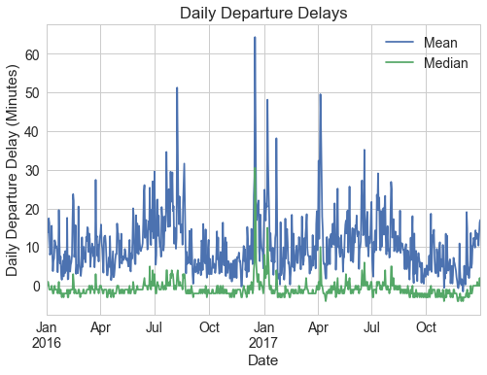
Trends Over Time
Short term fluctuations.
Long term variations.
Delays tend to be largest in the summer months and smallest in the fall months, with a few exceptions.

Slide 16
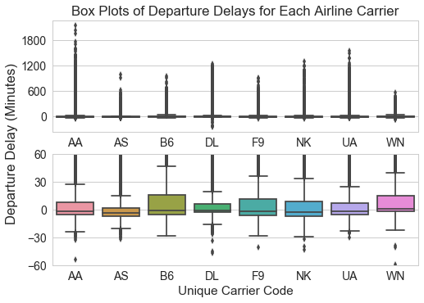
Departure Delay Distributions for Airline Carriers
Many of the departure delays are between -30 minutes and 30 minutes.
The medians range from -4 minutes to 1 minute.
The distributions are positively skewed.
JetBlue Airways Corporation (B6) was considered the worst performer. It had the largest mean, sample standard deviation, and interquartile range.

Slide 17
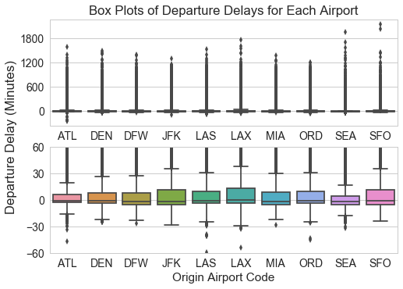
Departure Delay Distributions for Airports
Many of the departure delays are between -30 minutes and 30 minutes.
The medians range from -2 minutes to 0 minutes.
The distributions are positively skewed.
John F. Kennedy International Airport (JFK) was considered the worst performer. It had the largest mean and sample standard deviation.

Slide 18
Analysis Part 2
Weather conditions

Slide 19
Independent Weather Observations
Many weather observations were too close together to be considered independent.
Two sample datasets were created by selecting observations that were separated by 7 hours or more:
Dataset DS_DW (Delays & Weather)
Dataset DS_W (Weather)
Data was processed to prepare DS_DW and DS_W for analysis.
Weather observations in the sample datasets were treated as independent.

Slide 20
Sample Datasets
Flight Data
Preprocessing
Weather Data
Merged Dataset
DS_DW was used to analyze relationships between departure delays and weather variables.
DS_W was used to analyze the weather conditions at the airports.
Processing
DS_DW
DS_W

Slide 21
Weather Conditions
Weather conditions were defined for this analysis based on the present weather codes.
Weather condition categories:
RAIN – Rain or drizzle.
FOG – Fog, shallow fog, or mist.
SNOW/ICE – Snow, hail, snow pellets, ice pellets, snow grains, or ice crystals.
CLEAR – No present weather groups reported.
OTHER – Everything else. This includes observations with multiple present weather groups (e.g., rain and fog).
One weather condition category was assigned to each data point.

Slide 22


Comparison to Clear Conditions
Student’s t-tests were performed to compare the mean departure delays for RAIN, FOG, SNOW/ICE, and OTHER to the mean departure delay for CLEAR.
Significance level ⍺ = 0.05.
The null and alternative hypotheses for each test are: where WC = RAIN, FOG, SNOW/ICE, or OTHER.
The results indicate that the mean departure delays for RAIN, SNOW/ICE, and OTHER are significantly higher than the mean departure delay for CLEAR.
Mean departure delay and count for each weather condition, as well as the t-score and p-value for each Student’s t-test.
Weather Condition | Count | Mean Departure Delay (Minutes) | t-score | p-value
RAIN | 519 | -0.29 | 1.73 | 0.0420
FOG | 349 | -1.13 | -0.46 | 0.6789
SNOW/ICE | 58 | 1.91 | 1.86 | 0.0337
CLEAR | 17,714 | -0.93
OTHER | 525 | 1.80 | 3.33 | 0.0005
$$H_{0}: μ_{CLEAR}=μ_{WC}$$
$$H_{a}: μ_{CLEAR}<μ_{WC}$$

Slide 23
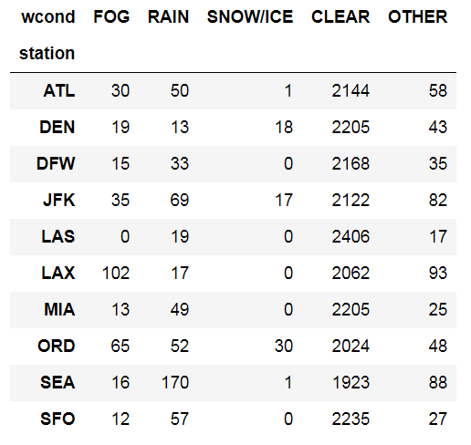
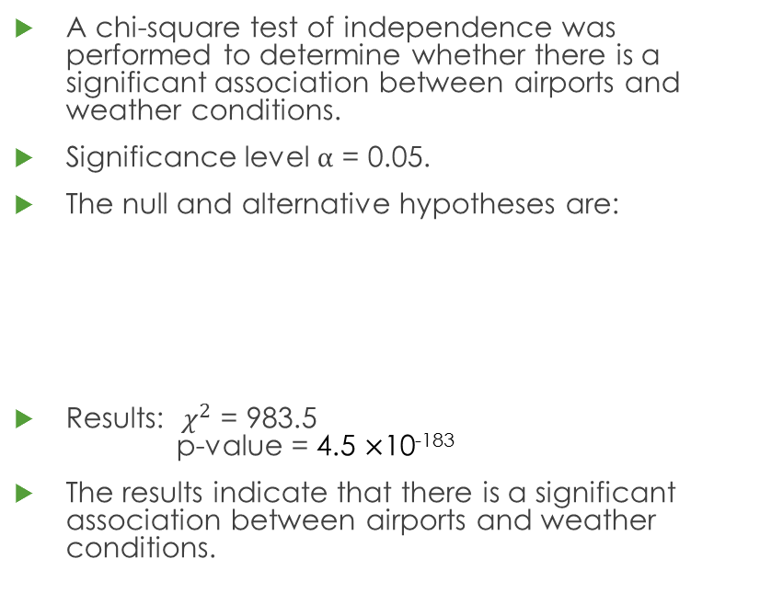


Weather Conditions at Airports
A chi-square test of independence was performed to determine whether there is a significant association between airports and weather conditions.
Significance level ⍺ = 0.05.
The null and alternative hypotheses are:
Results: $χ^{2}$ = 983.5 p-value = 4.5 $×$10⁻¹⁸³
The results indicate that there is a significant association between airports and weather conditions.
Contingency table with observed frequency counts for weather conditions at airports.
$$H_{0}:\text{There} \text{is} \text{no} \text{relationship} \text{between} \text{airports} \text{and} \text{weather} \text{conditions}\text{.}$$
$$H_{a}:\text{There} \text{is} \text{a} \text{relationship} \text{between} \text{airports} \text{and} \text{weather} \text{conditions}\text{.}$$

Slide 24
Analysis Part 3
Important weather variables

Slide 25
Lasso Regression
A Lasso regression was performed to determine the most important weather variables.
Departure delay was used as the target variable.
The following weather variables were used as the features:
The features were standardized. The target variable was not standardized.
The tuning parameter ⍺ = 0.02 was used. This value was chosen by performing two sequential grid searches using 10-fold cross-validation.
Air temperature
Relative humidity
Wind speed
Pressure altimeter
Visibility
Sky level 1 altitude

Slide 26
Lasso Regression Results
Slope coefficients and their corresponding p-values.
Standardized Feature | Coefficient (Minutes) | p-value
Air Temperature | 0.2667 | < 0.001
Relative Humidity | -0.3260 | < 0.001
Wind Speed | 0.4389 | < 0.001
Pressure Altimeter | -0.1966 | 0.006
Visibility | -0.2766 | < 0.001
Sky Level 1 Altitude | -0.4532 | < 0.001
R² = 0.01. Increasing the model complexity could result in a higher R² value. Such a task is beyond the scope of this analysis.
The p-values are all below a conservative significance level of ⍺ = 0.01.
The results indicate that the slope coefficients are all significantly different from 0.
Sky level 1 altitude and wind speed were the two most important features.

Slide 27
Conditional Linear Regressions
Two conditional linear regressions were performed to examine the relationship between departure delay duration and sky level 1 altitude.
One regression included all departure delays. The other regression excluded departure delays of 1 hour or greater.
All weather variables other than sky level 1 altitude and coverage were restricted to ideal conditions.
Data points with clear skies were excluded from these regressions.
Similarly, a conditional linear regression was performed to examine the relationship between departure delay duration and wind speed.
All weather variables other than wind speed were restricted to ideal conditions.

Slide 28
Ideal Conditions
The following ideal conditions were defined for this analysis:
Sky level 1 coverage is CLR or SKC.
Sky level 1 altitude = 42,000 feet.
Weather condition is CLEAR.
Visibility = 10 miles.
Wind Gust is a missing value.
29.7 inches ≤ Pressure altimeter ≤ 30.3 inches.
One hour precipitation = 0 inches.
Wind speed ≤ 10 knots.
Relative humidity ≥ 50%.
40 degrees F ≤ Air temperature ≤ 90 degrees F.

Slide 29
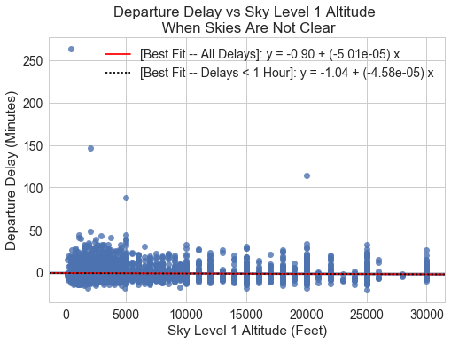
Sky Level 1 Altitude
Coefficient of determination and slope coefficient p-value for each conditional linear regression.
Delays Used in Regression | R² | Slope Coefficient p-value
All Delays | 0.002 | < 0.001
Delays < 1 Hour | 0.003 | < 0.001
The results indicate that the slope coefficients are significantly different from 0.
The models predict that a decrease of 30,000 feet in the sky level 1 altitude will increase departure delay durations by 1.38 to 1.50 minutes, under the appropriate conditions.
Sky level 1 altitude is of practical significance.

Slide 30
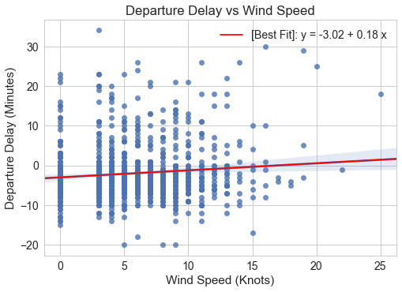
Wind Speed
R² = 0.011.
Slope coefficient p-value = 0.001.
The results indicate that the slope coefficient is significantly different from 0.
The model predicts that an increase of 25 knots in the wind speed will increase departure delays by 4.4 minutes, under the appropriate conditions.
Wind speed is of practical significance.

Slide 31
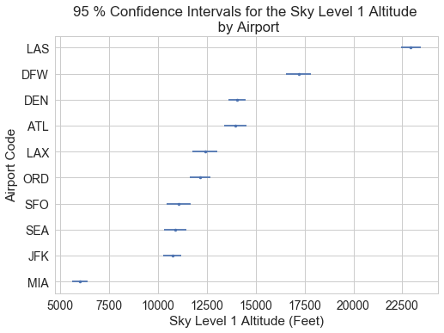
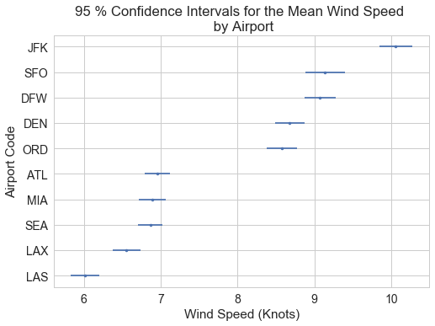
Mean Sky Level 1 Altitudes and Wind Speeds

Slide 32
Conclusion

Slide 33
Summary
Many flights departed within several minutes of the scheduled departure time.
Departure delays generally tended to be longest in the summer months and shortest in the fall months.
Weather conditions RAIN, SNOW/ICE, and OTHER had higher mean departure delays compared to CLEAR.
The regressions indicated that Sky level 1 altitude and wind speed are of practical significance.

Slide 34
Recommendations
The worst performers could be prioritized in investigations about ways to reduce departure delay durations.
JetBlue Airways Corporation was the worst performing airline carrier.
John F. Kennedy International Airport was the worst performing airport.
Airport authorities could anticipate increased departure delays when scheduling departures under certain conditions:
Summer months.
RAIN or SNOW/ICE. The OTHER category should be examined in more detail.
High wind speed.
Low sky level 1 altitude.
Summer months could be prioritized in investigations about the causes of the seasonal trends in departure delay duration.
Additional variables could be incorporated, such as passenger demand and airport capacity.

Slide 35
Potential Follow Up Analysis
The results of this analysis could be expanded upon in the following ways:
Investigate weather conditions at airports in more detail.
Separate the broad OTHER category into many different categories.
Investigate long delays in more detail.
Investigate ways to reduce departure delay durations under certain conditions:
Summer months.
RAIN or SNOW/ICE.
High wind speed.
Low sky level 1 altitude.
Increase model complexity for the regression analysis.

Slide 36
Thank you!
Any questions?

Slide 37
Additional Resources
This GitHub repository contains the final report and analysis code for this project.
Federal Meteorological Handbook No. 1 contains information about reporting standards for METARs.
Bureau of Transportation Statistics Glossary.

